Slide 1
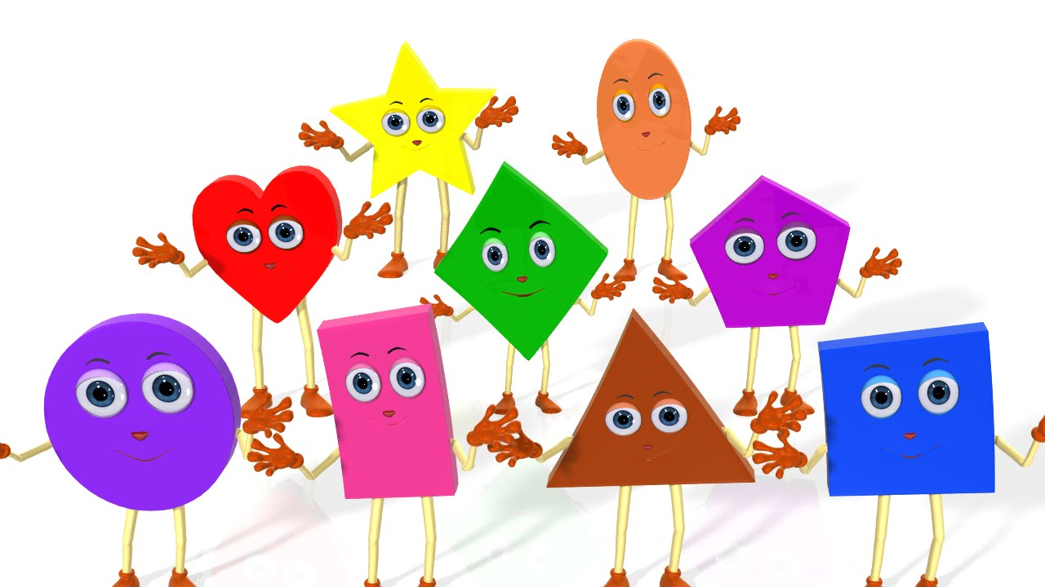
Shape, Space and Measure
Shape and size are concepts that are important for children to learn about. They form part of the Early Years Foundation Stage, shape, space and measures .
The aim of this workshop is to look at how we can plan and implement activities to help children learn about this concept

Slide 2
Reception
Aim:

Slide 3
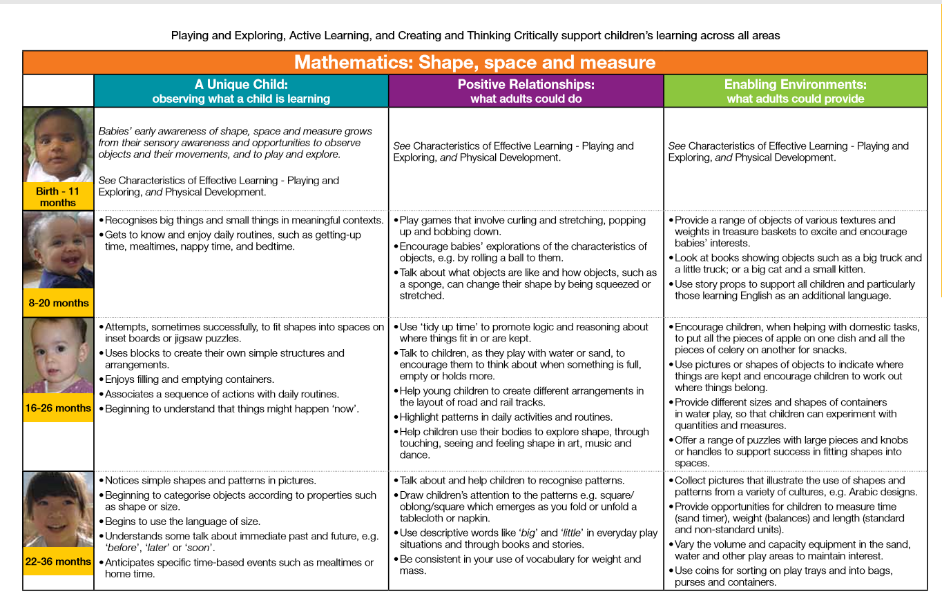
:

Slide 4
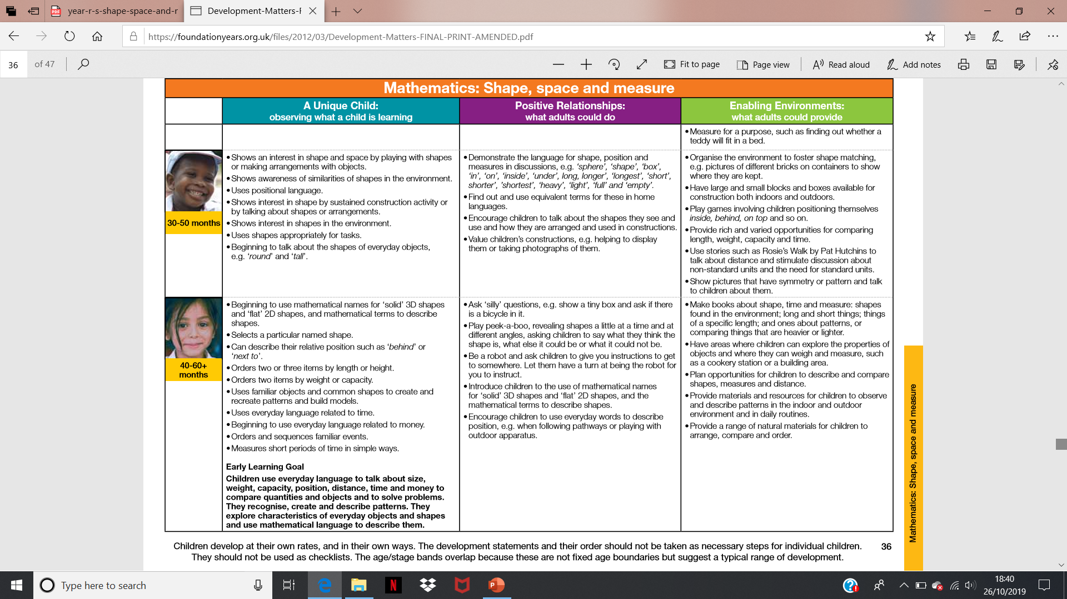
:
Children develop at their own rates, and in their own ways. The development statements and their order should not be taken as necessary steps for individual children.

Slide 14
Any Questions?

